Slide 1
Non-LSTM Based Models
With non-linear hidden-FC Layer
Without non-linear hidden-FC Layer
Image Input
Image Input
Feature extractor
Feature extractor
Pooling Layer
Pooling Layer
Non-Linear FC Layer
Linear FC Layer
Linear FC Layer
Audio Pressure Output
Audio Pressure Output

Slide 2
LSTM Based Models
With non-linear hidden-FC Layer
Without non-linear hidden-FC Layer
…
…
Image Input
Image Input
Image Input
Image Input
Image Input
Image Input
Feature extractor
Feature extractor
…
Feature extractor
Feature extractor
Feature extractor
…
Feature extractor
…
…
Pooling Layer
Pooling Layer
Pooling Layer
Pooling Layer
Pooling Layer
Pooling Layer
LSTM Layer
LSTM Layer
Non-Linear FC Layer
Linear FC Layer
Linear FC Layer
Audio Pressure Output
Audio Pressure Output

Slide 3
Best single-input model (61)
…
Image Input
Image Input
Image Input
VGG16
VGG16
…
VGG16
…
GAP Layer
GAP Layer
GAP Layer
32 input, non-causal LSTM layer with 128 output neurons and 20% dropout
FC layer, 128 hidden neurons with tanh activation
20% dropout
FC Layer, single linear output neuron
Audio Pressure Output

Slide 4
LSTM Based Models
With non-linear FC Layer, LSTM at output
Without non-linear FC Layer, LSTM at output
…
…
Image Input
Image Input
Image Input
Image Input
Image Input
Image Input
Feature extractor
Feature extractor
…
Feature extractor
Feature extractor
Feature extractor
…
Feature extractor
…
…
Pooling Layer
Pooling Layer
Pooling Layer
Pooling Layer
Pooling Layer
Pooling Layer
Non-Linear FC Layer
Non-Linear FC Layer
…
Non-Linear FC Layer
Linear FC Layer
Linear FC Layer
…
Linear FC Layer
Linear FC Layer
Linear FC Layer
…
Linear FC Layer
LSTM Layer
LSTM Layer
Linear FC Layer
Linear FC Layer
Audio Pressure Output
Audio Pressure Output

Slide 5
Auxiliary Input Models
Auxiliary input model without LSTM
Auxiliary input model with LSTM
…
Image Input
Image
Image
Image
Feature extractor
Feature extractor
…
Feature extractor
Feature extractor
FasterRCNN Features
FasterRCNN Features
…
Pool
Pool
Pool
Pooling Layer
LSTM Layer
Non-Linear FC Layer
Non-Linear FC Layer
Non-Linear FC Layer
Non-Linear FC Layer
Non-Linear FC Layer
Non-Linear FC Layer
Linear FC Layer
Linear FC Layer
Audio Pressure Output
Audio Pressure Output

Slide 6
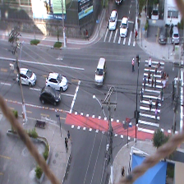
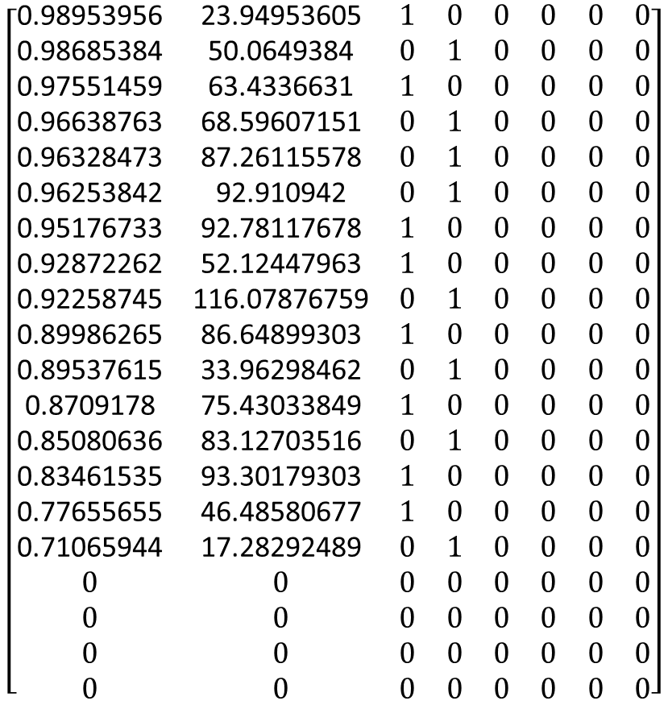


FasterRCNN features input tensor
Confidence score
Bounding box $\sqrt{area}$
One-hot representation of class
$$\left[\begin{matrix}\text{0.98953956} & \text{23.94953605} & 1 & 0 & 0 & 0 & 0 & 0 \\ \text{0.98685384} & \text{50.0649384} & 0 & 1 & 0 & 0 & 0 & 0 \\ \text{0.97551459} & \text{63.4336631} & 1 & 0 & 0 & 0 & 0 & 0 \\ \text{0.96638763} & \text{68.59607151} & 0 & 1 & 0 & 0 & 0 & 0 \\ \text{0.96328473} & \text{87.26115578} & 0 & 1 & 0 & 0 & 0 & 0 \\ \text{0.96253842} & \text{92.910942} & 0 & 1 & 0 & 0 & 0 & 0 \\ \text{0.95176733} & \text{92.78117678} & 1 & 0 & 0 & 0 & 0 & 0 \\ \text{0.92872262} & \text{52.12447963} & 1 & 0 & 0 & 0 & 0 & 0 \\ \text{0.92258745} & \text{116.07876759} & 0 & 1 & 0 & 0 & 0 & 0 \\ \text{0.89986265} & \text{86.64899303} & 1 & 0 & 0 & 0 & 0 & 0 \\ \text{0.89537615} & \text{33.96298462} & 0 & 1 & 0 & 0 & 0 & 0 \\ \text{0.8709178} & \text{75.43033849} & 1 & 0 & 0 & 0 & 0 & 0 \\ \text{0.85080636} & \text{83.12703516} & 0 & 1 & 0 & 0 & 0 & 0 \\ \text{0.83461535} & \text{93.30179303} & 1 & 0 & 0 & 0 & 0 & 0 \\ \text{0.77655655} & \text{46.48580677} & 1 & 0 & 0 & 0 & 0 & 0 \\ \text{0.71065944} & \text{17.28292489} & 0 & 1 & 0 & 0 & 0 & 0 \\ 0 & 0 & 0 & 0 & 0 & 0 & 0 & 0 \\ 0 & 0 & 0 & 0 & 0 & 0 & 0 & 0 \\ 0 & 0 & 0 & 0 & 0 & 0 & 0 & 0 \\ 0 & 0 & 0 & 0 & 0 & 0 & 0 & 0\end{matrix}\right]$$
Number of classes found
$$\left[\begin{matrix}8 \\ 8 \\ \begin{aligned}0 \\ 0 \\ 0 \\ 0\end{aligned}\end{matrix}\right]$$
Image 44 from video #9
Counting representation
One-hot representation

Slide 7
Dataset loading
Non-LSTM
LSTM (causal)
Frame 0
Frame 1
Frame 2
Frame 3
Frame 4
Frame 0
Frame 1
Frame 2
Frame 3
Frame 4
Out 0
Out 1
Out 2
Out 3
Out 4
Out 2
Out 3
Out 4

Slide 8
Dataset loading
LSTM (causal)
LSTM (non-causal)
Frame 0
Frame 1
Frame 2
Frame 3
Frame 4
Frame 0
Frame 1
Frame 2
Frame 3
Frame 4
Out 2
Out 3
Out 4
Out 1
Out 2
Out 3

Slide 9
LSTM block
c[t-1]
X
+
c[t]
tanh
f
X
X
i
o
c*
sig
tanh
sig
sig
+
+
+
+
h[t]
h[t-1]
BIAS
BIAS
BIAS
BIAS
x[t]

Slide 10

Arquitetura da VGG16
Convolução + ReLu
Max Pooling
FC+ ReLu
Softmax
“cat”
Extrator de Características
Camadas FC

Slide 11
x
y

Slide 12
Image
7x7 conv, 64, /2
pooling, /2
3x3 conv, 64
3x3 conv, 64
3x3 conv, 64
3x3 conv, 64
3x3 conv, 64
3x3 conv, 64
3x3 conv, 128, /2
3x3 conv, 128
3x3 conv, 128
3x3 conv, 128
3x3 conv, 128
3x3 conv, 128
3x3 conv, 128
3x3 conv, 128
3x3 conv, 256, /2
3x3 conv, 256
3x3 conv, 256
3x3 conv, 256
3x3 conv, 256
3x3 conv, 256
3x3 conv, 256
3x3 conv, 256
3x3 conv, 256
3x3 conv, 256
3x3 conv, 256
3x3 conv, 256
3x3 conv, 512, /2
3x3 conv, 512
3x3 conv, 512
3x3 conv, 512
3x3 conv, 512
3x3 conv, 512
avg pooling
FC 1000

Slide 13
Grid size reduction
Grid size reduction
Convolution
Max Pooling
Average Pooling
Concatenate
Softmax
Dropout Fully connected
Auxiliary classifier

Slide 14
all videos µs and σs
calculate
µ and σ
images
concatenate
normalize
images
model input
extract frames, downsample, resize
images (model input)
images
video file
images
extract audio and calculate sound pressure
targets (model output)
targets
concatenate
targets
model output
targets
targets
(a)
(b)

